Slide 1
Reflection on a first CLIL experience within a English BA-Program
-CLIL4ALL Workshop in Córdoba-
JOHN O'DONOGHUE & SANDRA HAAS

Slide 2
AGENDA
# Introduction to the CLIL Setting
# My CLIL experience – in a nutshell
# Outcome of our reflection process
# What is specific about CLIL in higher education context in an English study program?

Slide 3
# Introduction to the CLIL Setting
  Specialization, course, students
  Classification in team teaching forms
# My CLIL experience – in a nutshell
  A picture by John
  A picture by Sandra
# Outcome of our reflection process
  What was going well, why?
  What was not going so well, why?
  What did we derive from?
# What is specific about CLIL in higher education context in an English study program?
  In regard to Team teaching
  In regard to Language teaching
# Q&A
AGENDA

Slide 4
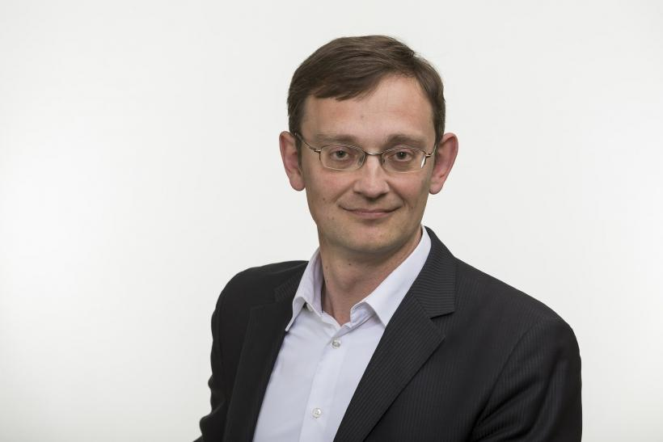
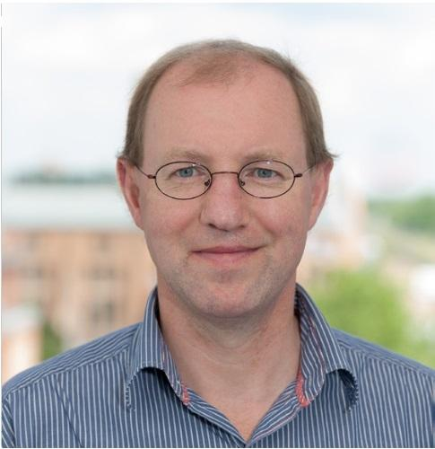
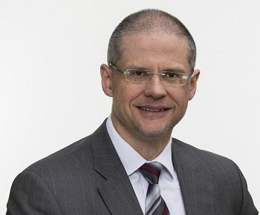

Introduction to the CLIL Setting
20 CP Mandatory Specialization in the Bachelor-Program „European Business Management“
CLIL= 1st implementation SS23
-> Bottom-up initiative
International and Institutional Economics
International Strategies in Theory & Practice I
International
Strategies in Theory & Practice II
International and Institutional Economics II
LANGUGE SKILLS
These European Business Management students were either bilingual students or those with a high level of proficiency in English. Therefore, they were fluent in informal spoken interaction.
There were a few students who were less confident in speaking English but they were a small minority.
Some linguistic help was provided on the Moodle course, in terms of technical terms regarding international business.
4th
+
5th
CLIL= 1st implementation WS24

Slide 5
Introduction to the CLIL Setting
Classification in Team Teaching Forms
Planning | Implementation
Type | Concept | Implementation | Reflection
First imple-mentaion
2nd++
imple-mentaion
Team Matrix according to Dirk Rohr, Hendrik den Ouden & Eva-Maria Rottlaender (2016): Hochschuldidaktik im Fokus von Peer Learning und Beratung, p. 69.
Friend, M. D., & Bursuck, W. D. (2009). Including students with special needs: A practical guide for classroom teachers (5th ed.). Columbus, OH: Merrill, p. 88

Slide 6
# Introduction to the CLIL Setting
  Specialization, course, students
  Classification in team teaching forms
# My CLIL experience – in a nutshell
  A picture by John
  A picture by Sandra
# Outcome of our reflection process
  What was going well, why?
  What was not going so well, why?
  What did we derive from?
# What is specific about CLIL in higher education context in an English study program?
  In regard to Team teaching
  In regard to Language teaching
# Q&A
AGENDA

Slide 7

My CLIL experience – in a nutshell
John

Slide 8

My CLIL experience – in a nutshell
Sandra
Structured
ambitious// high expectations from students
Interactive, but too fast
Kind of perfectionistic in planning & design
Experiences teaching content to Germans/Internationals in English language
Less Structured & very flexible
Very Student-friendly
Interactive, but talks a lot too.
“see as it goes” approach
Experiences with Germans learning English
CHALLENGE
CONTENT-Country
Plan and implement a trip together where participants experience a coherent travel experience of the two countries in a limited time and meet a set of skill requirements set by the residents of each country.
Conditions:
Participants must perceive the countries as a symbiosis and not as individual parts.
15 weeks
LANGUAGE-Country
Words, words, words
information
Mgt. expectations &
competences
methods
Opinions, views
Concepts
Students smile, have fun
planning
… becoming managers
Reading, Listening, writing, hearing
Notes:
Fachkulturen//

Slide 9
Content teachers and language teachers: closed vs. open closed system? (Trent 2010)
Content teachers generally:
regard ‘real world’ in terms of finite skills and knowledge
Teacher controls class to transmit knowledge
Align teaching with syllabus and exams
Language teachers tend to:
Define ‘real world’ as uncertain and beyond sets of skills and knowledge
Emphasize negotiation, challenge to knowledge, lack of predetermined answers
Align teaching with challenges of real communication.
Notes:
Technical university, university of applied sciences. As a language teacher if people are talking, things are working (well).

Slide 10
# Introduction to the CLIL Setting
  Specialization, course, students
  Classification in team teaching forms
# My CLIL experience – in a nutshell
  A picture by John
  A picture by Sandra
# Outcome of our reflection process
  What was going well, why?
  What was not going so well, why?
  What did we derive from?
# What is specific about CLIL in higher education context in an English study program?
  In regard to Team teaching
  In regard to Language teaching
# Q&A
AGENDA

Slide 11

Outcome of our reflection process
What was going well, why?
1 min.
Good fit of the team teachers (high motivation & commitment to CLIL & the teaching project, similar vision of the educational ideals, willingness to invest more time)
Our relationship as team teachers was characterized by openness, commitment, trust & respect for each other
There were inital steps in allocating team-based tasks according to individual strength & interests:
  Sandra: Planning & Organisation//Content Management learning platform// graphic design
  John: Critical friend, Creator of good atmosphere in course, relationship management to students
We layed the foundations for a practical collaboration:
  Cloud (overall planning of the specialisation with the participation of all 4 teachers; joint kick-off for the specialisation/ sub-folders for each course with subdivision (1) teaching concept; (2) slides event and (3) materials).
  For each course we had developed a teaching concept incl. objectives CONTENT, a distribution of time, roles and To Do's, which proved to be very helpful in the implementation.
In regard to a sustainable implementation of CLIL, our reflections at the end of each session helped alot for further optimization.
Students seemed to be o.k. with the team teaching.

Slide 12
Outcome of our reflection process
What was going well, why?

Slide 13
Outcome of our reflection process
What was going well, why?

Slide 14
Outcome of our reflection process
What was going well, why?
What was going so well.. | Reason why
Good fit of the team teachers | bottom-up initiative of CLIL/ No teacher was forced to We know each other since years// are in the same faculty We collaborated in other projects (outside of teaching) Regular talks about students competences in English & expectations of HEI
Team teaching relationship (openness, commitment, trust & respect ) | This was in the hand of both of us and it seemed to be also important for us. It was there from the start. OPENNESS: LANGUAGE-> motivated & curious to consider additional effort to study CONTENT by one self CONTENT-> motivated & curious to learn about language teaching; “words are important” approach COMMITMENT: Bottom up initiative, both teachers wanted CLIL and were motivated to shape one education product collaboratively in planning & implementation MAYBE also cross-cultural experiences- in the sense of culture related to academic discipline???

Slide 15
Outcome of our reflection process
What was not going well, why?
1 min.
Despite planning, some teaching elements were not so well aligned with each other (in terms of time, content, staff).
Despite the fact that we had many things in common as teachers, differences also became clear or it became apparent that we had never discussed central design aspects or results together.
  Different experiences/views, for example in the use of digital teaching.
  Differences in the teaching of CONTENT & LANGUAGE.
  Personalities: Sandra (very structured) vs. John (more spontaneous, go with the flow).Learning objectives are not coherent// LANGUAGE was predominantly missing here or has not yet been finalized.
  Open question: What do we understand by a coherent picture or final result and where are our limits - what are our expectations?
The additional workload was not recognized in terms of official teaching hours. This applies in particular to LANGUAGE.
Evaluation schemata was not suitable: Due to their good language competences, students did not prepare well for the oral examination in terms of content (problematic weighting). The expectations of the language competences and learning objectives were too low.
From CONTENT's point of view, LANGUAGE can be integrated even better and LANGUAGE should be given even greater weight (50:50 SWS split// higher performance expectations).
Students probably did not realise the value of CLIL nor our team teaching. For them it was simply a changing teaching setting and therefore welcomed. Why, how we work together was unclear.

Slide 16
Outcome of our reflection process
What was not going well, why?
These students definitely possess BICS (Basic Interpersonal Communication Skills,) probably Advanced Interpersonal Communication Skills. What they lack is CALP (Cognitive Academic Language Proficiency) - Cummins 1981. Academic language is characterized by being abstract, context reduced and specialized. This became clear in the oral exam where many of the responses were general, vague, superficial and, at times, rambling. The answers indicated that the students had learnt off the content of the course slides using lower-order skills but had not been using the higher order skills (analysing, critically reflecting, differentiating, prioritizing, justifying). Whether they were not being analytical because they lacked the language is debatable.
So there is some place for what Coyle, Hood and Marsh call ‘form-focused lessons … for linguistic accuracy as opposed to fluency.’ in the academic sense. High level language modelling should provide them with the phrases for more analysis and indicate the content level which the professor expects.
Question: Are lecturers not modelling this language and approach or are students not imitating it?

Slide 17
Outcome of our reflection process
What was not going well, why?
Listing/signalling: There are three reasons why companies choose to locate abroad: The first/second/third. The most important reasons seems to be/the second most important reason might be considered to be/the third reason in my opinion, especially in the case of X companies, may be …
  Examples: It is reasonable to assume/it might be fair to suppose/it is rational to infer that/… [structure: it is (adjective) to (infinitive) … ]
The students should be able to modulate levels of epistemic certainty and uncertainty, using hedging devices and appropriate phrases to adopt a variety of stances regarding the truth-value of their observations or judgements.
It is planned in the following year when the course is offered again to model such phrases to the students.

Slide 18
Outcome of our reflection process
What was not going well, why?
What was going so well.. | Reason why
Misfit of teaching elements | Mistakes in Planning// Plan versus Implementation Sometimes LANGUAGE took more time than planned. | 1st trial experiences: No experiences in CLIL in HEI
Differences among Team teachers | - We never met each other live in our teaching role, so different approaches were unknown to us. We had not spoken about how the final “product” should look like.
Evaluation schemata was not suitable | Tactic, strategic behaviour of students was underestimated. Expected competences in English were set to low/ not communicated appropriately. Constructive Alignment was not properly worked out for good English speakers
LANGUAGE was not best integrated | CONTENT was going first in planning, LANGUGE waited for tasks, requirements
High effort versus SWH acountability | Misfitting resources for innovative concepts in teaching Team teaching is not adaquatly regarded in accounting terms
Perceived value of CLIL by students | Constructive Alignment was not properly worked out for good English speakers Cohort are not high performers/ problems with motivation in general Perception on LANGUAGE Classes based on former experiences

Slide 19
# Introduction to the CLIL Setting
  Specialization, course, students
  Classification in team teaching forms
# My CLIL experience – in a nutshell
  A picture by John
  A picture by Sandra
# Outcome of our reflection process
  What was going well, why?
  What was not going so well, why?
  What did we derive from?
# What is specific about CLIL in higher education context in an English study program?
  In regard to Team teaching
  In regard to Language teaching
# Q&A
AGENDA

Slide 20
Outcome of our reflection process
What did we derive from?
Planning | Joint planning of lectures with objectives, procedures and responsibilities is essential and the starting point for cooperation. In the 1ST YEAR of practise, CONTENT can/should precede in order to create structure and to offer LANGUAGE a point of reference. Starting with the 2ND YEAR, greater symbiosis between the two subjects needs to be worked on, which should go hand in hand with an "emancipation" of LANGUAGE. LANGUAGE defines competence skills in Listening, Reading, Speaking and Writing according to Bloom that are harmonised with CONTENT. CONTENT thinks even more about which content elements are rather LANGUAGE elements or are strongly related to LanguageContent specifies expectations of language skills based on content and teaching experience Team-related tasks should be discussed/distributed again after the first round; strengths & interests-led Set up a responsibility matrix-> Who is doing what? Tracking of teaching effort to identify unbalances at an early stage

Slide 21
Outcome of our reflection process
What did we derive from?
Team Formation | A fit of the team partners is a basic requirement, but it does not replace further discussions to learn about each other's ideas, experiences, strengths, etc. and to build and maintain a common understanding of the end product. The fit should focus more on the characteristics of openness, commitment, trust & respect for each other. Differences in teaching approach/experience should be addressed and taken into account according to one's own strengths, interests and possibilities - congruence is not necessary here.In my view, the motivation of teachers is a key to success. You have to want to create a joint teaching product from CLIL and from your own initiative in team teaching. There should be a mutual agreement that CONTENT can also teach LANGUAGE and LANGUAGE can also teach CONTENT.
 | A two-way teaching observation prior to team teaching is recommended.
Allocation of teaching ressources & Crediting | Higher crediting of teaching effort for first practice-> CLIL alike other forms of team teaching must be seen as valuable (resource) for HEI CLIL and the team teaching partnership should be designed for the longer term. CLIL is a process and is not suitable as a flash in the pan
Communication to the students | => Clear communication towards the students (purpose, method practices of team teaching, responsibility matrix)

Slide 22


What is specific about CLIL in higher education context in an English study program?
In regard to team teaching
In the invisible part, the roles of CONTENT and LANGUAGE converge:
CONTENT: Now also thinks and acts from the perspective of LANGUAGE. (see Reflection screen-> Country Language)
LANGUAGE: certain competences from the content area are taught under guidance.
Impact on the teachers image by students
=> CONTENT will be presuming perceived “softer” (see people from the LANGUGE country)
=> LANGUAGE will be presuming perceived “tougher” (see people from the CONTENT country)
Experiencing cross-cultural experiences changes your own understanding of your role as a teacher
Do I want this change of role and the associated change of exteral image (by students)?
What risks and opportunities are associated with this for me?=> How can I shape my new role in a way that makes sense for me?

Slide 23
What is specific about CLIL in higher education context in an English study program?
In regard to team teaching
Scaffolding upward:
Students were using fluent everyday language to cover up content gaps.
Standard of language needs to be seriously increased to C1 and C2. Questions in exam should reflect this: EVALUATING. Appraise, argue, defend, judge, select, defend, value, critique, weigh. Second top of Bloom‘s taxonomy. Language training in the semester should scaffold this.
=> At this level students do not need scaffolding from their B2/C1 level of general English to content English but scaffolding from C1 general level of proficieny to a demanding focussed level of academic precision that is cognitively demanding. Language is the tool that enables the students to reach level of expression that are demanded at Higher Education Institutes.
Link to critical thinking.
Video: Oil in Ghana. Whose side is the narrator on? When do you notice this stance? Visually and linguistically (labels)? Is neutrality in reporting human rights abuses neutral? Desirable?
Or ethical? Similar in Friedman‘s discussion on globalization.

Slide 24
Questions and discussions are very welcome ☺

Slide 25
Appendix
Reflection CONTENT Teacher- level documentation
Before the Implementation:
Since I had already wanted to weave CLIL into the reform of our Bachelor's degree programmes several years ago on my own initiative and had also formulated a DAAD application for this purpose, I was highly motivated to include CLIL in the specialisation "Int. In EU Context" specialisation. The module description was developed in collaboration with Martin Bradbeer. I was looking forward to the realisation of CLIL and my soon to be CLIL experience & collaboration with Vicky. I saw an advantage in thinking about the development of language and subject-related competences together.
At the same time, I suspected synergies that would lead to time savings on my part in the long term (due to focussing).
I was aware of the high coordination effort: (Be prepared!) Because I had already taught similar content in other events on my own, I took on the planning responsibility. Vicky always expressed that content leads the way and tells the language teacher what is needed. Together with Vicky and other representatives of the specialisation (Int. Mgt. in EU Context, 4*5 CP), we worked on the rough roadmap for the specialisation and the topics for the joint kick-off, including the distribution of tasks.
(Comment: translated by DeepL)

Slide 26
Appendix
Reflection CONTENT Teacher- level documentation
During the Implementation:
Not everything went so well during the implementation - but I think we achieved a lot in a short space of time for a first attempt. The time required for planning was immense, and in retrospect I think we didn't take enough time to discuss the actual implementation. I had no problem making the initial pitch for the joint course planning - it even helped me to think more carefully about which elements I didn't actually have to or shouldn't have to communicate directly. Therefore, I would even say that CONTENT should go first for the initial implementation. This makes it much easier for LANGUAGE. However, it may also be because the content was not new to me, but I was able to build on existing events.
Sometimes I would have liked Vicky and John to have made more suggestions of their own. Especially at the beginning I had the impression that Vicky expected me to define what LANGUAGE should deliver. And so I asked myself whether there were any competence targets in Language that she would like to achieve. Overall, I felt there was a lack of reference to taxonomy.
Due to Vicky's quick departure from the module, John and I were practically thrown into the CLIL co-operation. As John had an above-average amount of teaching, we had even less time to talk about our planning and implementation. Logically, John "simply" followed my planning. We still don't have any language goals at the level of individual courses.
Through observations in the realisation, I first noticed the differences in the teaching of LANGUAGE and CONTENT. Through ongoing conversations with John, I was able to develop an understanding of teaching a foreign language - as well as potentials for our joint teaching product.
John worked very hard to familiarise himself with my materials and was always prepared for the event.
(Comment: translated by DeepL)

Slide 27
Appendix
Reflection CONTENT Teacher- level documentation
During the Implementation:
When we come to the things that didn't go so well, the following important experiences should be emphasised:
I think the students didn't really understand our team teaching and what it's all for and why they are now getting language training in English again. The students didn't recognise the added value of CLIL - although some of them already had CLIL experience (bilingual high school).
I also thought it was bad that the participation of the students was low. Even with really nice things like a conversation about a film that leaves the viewer with impressions and inspires critical questions about yourself/your career path.
It was characterised by the fact that the students invested little - and did so consciously. They had little interest in deeper thinking - but in "gut knowledge" and discussions about statistics. I think the students didn't really understand or anticipate the demands placed on them.
4. The exams were depressing for John and me. The students didn't take the module seriously and didn't prepare very well - despite being given a comprehensive list of questions at level. Worst of all, they were clearly not interested in the topics of the course & the present.
(Comment: translated by DeepL)

Slide 28
Appendix
Reflection CONTENT Teacher- level documentation
After the Implementation:
After each course, we reflected separately in writing and recorded this in a collaborative document. Sometimes John didn't get round to it - then I entered my own verbal comments for him. It didn't bother me. Reflection and learning was very important to me as I believe we can create a much better end product. I also had the impression that all the writing down and planning wasn't John's thing. But it's very important to me and that's why I'm happy to take on this role. I experienced John's team-related role as a critical friend. He very often gave me advice and feedback on my teaching or on teaching methods in general. His feedback helped me to get out of my specialist bubble, to open up to other perspectives and also to become a little "softer" as a specialist lecturer.
What effect did CLIL have on John - it seemed to me that my topics and materials woke him up from his teaching rut with the German students. He developed a keen interest in my topics, got involved a lot and, with a few exceptions, found many things exciting.
We started optimising the next summer semester back in the summer. That was cool, as we came up with lots of new ideas and also some new language goals based on the planning - yeah! I'm looking forward to the coming summer term and feel that CLIL will enrich my teaching experience.
(Comment: translated by DeepL)

