Slide 1

WP 3
Pilots for team teaching model and CLIL elements
Pilot development discussions in spring 2023
1. Planning meeting with HAN and Karelia at 17.2.2023
Participants: Judith van de Looij, Stephan Plat (HAN)
Seppo Nevalainen, Varpumaria Jeskanen (Karelia)

Slide 2
CLIL elements
House of CLIL
Comprehension strategies, e.g. minutes, mind maps, classifying information, tables, graphs, visualisations…
What can be considered as targeted learning outcomes? How to follow up and measure?
Learning strategies
Listening skills
Vocabulary & Grammar
Thinking skills
Interaction skills
Reading skills
Speaking skills
Discussions, 1to1 w/ teacher, problem solving, analyzing, comparing, persuasion, expressing opinions…
Negotiations, simulations, case debates, games, role plays…
How to teach in a team? How to jointly evaluate/assess?
Teaching strategies
Team Teaching model

Slide 3
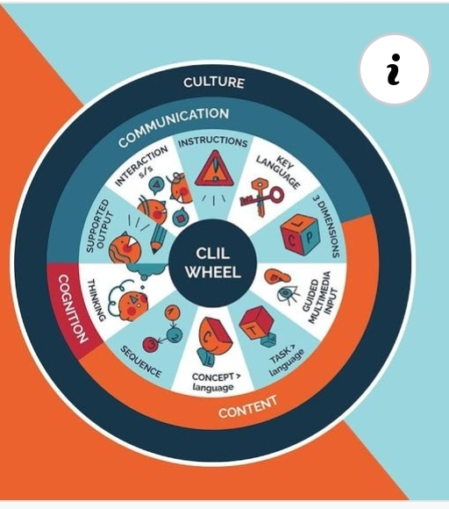
CLIL WHEEL
Decisions to take on
  Which elements to test in which pilots?
  What kind of assignments and evaluation do we use?
  How do we collect data?
  Timetables for designing and planning together + implementations?
https://clilmatters.com/clil-wheel-10-parameters-posters/

Slide 4
Different pilot implementations in WP3
Autumn 2023
Type 1: Light CLIL
  Pilots run independently in Karelia and HAN
  Different assignments in use (to test different CLIL elements)
  Feedback collected (students, teachers) for research
Type 2: semi-attached CLIL
  Assignments and evaluation designed together, different elements of CLIL are tested
  Implementations done separately in both partners Karelia & HAN, Karelia piloting team teaching model
  Feedback collected (students, teachers) for research
Type 3: Collaboration pilot
  One joint course with activities together (students have chance to interact and speak English)
  Project Management course? English teachers involved from both UAS’s?
  Feedback collected (students, teachers) for research
2024-2025
Type 4: Blended Intensive programme
  BIP 1 & 2

Slide 5
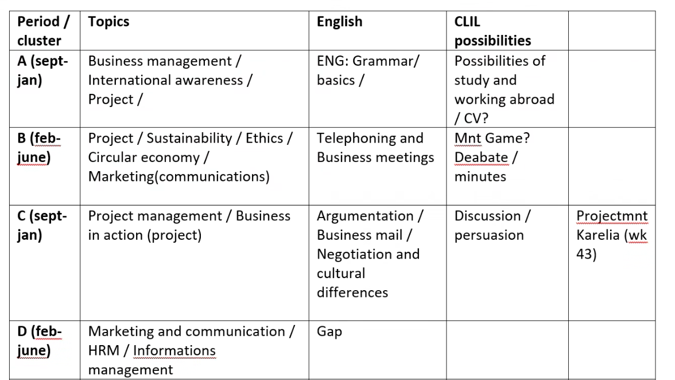
Piloting options in HAN -> to be discussed at HAN

Slide 6
Next meeting of WP 3
2.3.2023 at 11:30 Finnish time (HAN, Karelia, Cordoba)
Agenda:
  Draft proposal of the workshop contents for WP 3 at HAN (+ estimate for time) – Varpumaria prepares
  Follow up of progress: proposals for pilots (courses, teaching model, CLIL elements involved, type of CLIL implementation 1-4 (see below)) – both HAN & Karelia prepare
  Alignment with WP1, discussion of the pilot implementations, CLIL elements and data collection with Cordoba – Victor can join
  Agreeing the next steps before HAN workshop, scheduling meetings

Slide 7
CLIL4ALL WP 3
Pilots autumn 2023
2. Planning meeting with Cordoba, HAN and Karelia at 2.3.2023
Participants: Judith van de Looij, Stephan Plat (HAN)
Kirsi-Marja Toivanen, Varpumaria Jeskanen (Karelia)

Slide 8
Karelia UAS pilots, autumn 2023
Period | Topics (Courses) | Teachers (in pilots) | CLIL elements | CLIL type
Oct-Dec 2023 | Project Management (3 ECTS) & Intercultural Communication (2 ECTS) and Academic Communiction (3 ECTS) ~ 40-50 students | Varpumaria Jeskanen Kirsi-Marja Toivanen | Speaking & listening (Presentations/Pitches), teamwork in multicultural environment, Interaction (project meetings), minutes | CLIL type 2 & 3: Integration with HAN?
 | Digital Technology Essentials (5 ECTS) & Working in International Teams (2 ECTS) (NEW courses) | Seppo Nevalainen Heidi Vartiainen
Sep-Oct 2023 | Technical Sales and Bidding 3 ECTS | Heidi Vartiainen Varpumaria Jeskanen Hamid El Ouatki | Negotiation simulation, argumentation, sales documentation, vocabulary | CLIL type 1 or 2?

Slide 9
HAN UAS pilots, autumn 2023
Period | Topics (Courses) | Teachers (in pilots) | CLIL elements | CLIL type
Sept-Dec 2023 |  |  | Speaking & listening (Presentations/Pitches), teamwork in multicultural environment, Interaction (project meetings), minutes | CLIL type 2 & 3: Integration with HAN?
 | Digital Technology Essentials (5 ECTS) & Working in International Teams (2 ECTS) (NEW courses)
Sep-Oct 2023 | Technical Sales and Bidding 3 ECTS |  | Negotiation simulation, argumentation, sales documentation, vocabulary | CLIL type 1 or 2?

Slide 10
HAN UAS pilots, spring 2024
Period | Topics (Courses) | Teachers (in pilots) | CLIL elements | CLIL type

Slide 11
Alignment with WP 1
Discussion on the pilot implementations, CLIL elements and data collection with Cordoba
Decisions to take on
  Which elements to test in which pilots?
    Cordoba/Victor prepares a list of CLIL elements from the research to help in planning the contents for the pilots (HAN WS) -> additional discussion to the training agenda (Judith)
    pre-assignment for piloting teachers to prepare for the workshop (Stephan to discuss at HAN)
  What kind of assignments and evaluation do we use?
    HAN & Karelia start defining the elements + pilot areas, teachers need to be involved in planning assignments. We can start planning once teachers are selected (March 2023?)
  How do we collect data? What information should we collect?
    Discussion needed in HAN workshop
  Timetables for designing and planning together + implementations?
    Timetables to be agreed once teachers are defined.

Slide 12
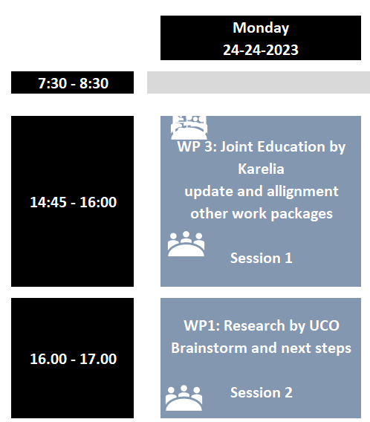
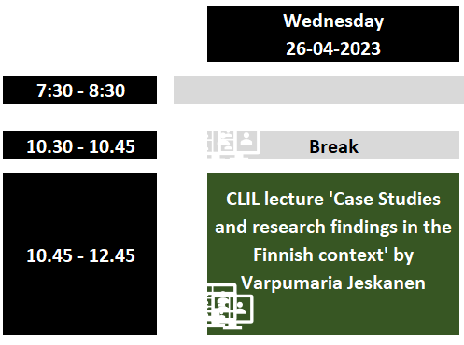
Proposal for WP 3 workshop at HAN
WP 3:
  Online meeting before the WS (end of March)
    Introduction of pilots, main contents, CLIL elements, timeline, possibility to comment + open questions (workshop orientation)
  1 h 15 min workshop on 24/4/2023 -> do we have enough time?
    Design & agreement on pilot contents and output
      Discussion on the expected output, documentation and evaluation
    Data collection and documentation: What information we collect, where to store it, how to share and use it?
    WP3 section in Cordoba F2F WS?
  1st Online WS with the teachers involved to pilots (May?)
    Setting the piloting framework
    Alignment of assignments, assessment and data collections
    + local workshops with teachers involved

Slide 13
Next steps and meetings
Next steps
  Scheduling a meeting with partners to present the idea for piloting - wk 13 or 14 /Varpumaria
  Discussion with teachers to agree the courses participating in pilots - wk 9-11 /HAN, Karelia
    Defining the CLIL elements for pilots
  List of CLIL elements for pilots on the basis of research /Victor provides wk 10
Meetings
  Joint online meeting with all the partners (wk 13-14)
  Preparation for training week on 13th April 2023

Slide 14
Pilot implementation plan
WP3 Project meeting 31.3.2023
All parties

Slide 15
WP3: pilots
CLIL4ALL
Agenda
  Pilot development: status update on the progress
  Pilot implementation plan
  Expected output from the pilots
  Open issues, comments
  Preparation for HAN WP3 workshop on Monday 24.4.2023
https://clilmatters.com/clil-wheel-10-parameters-posters/

Slide 16
Step 1 Defining CLIL elements
House of CLIL
Comprehension strategies, e.g. minutes, mind maps, classifying information, tables, graphs, visualisations…
What can be considered as targeted learning outcomes? How to follow up and measure?
Learning strategies
Listening skills
Vocabulary & Grammar
Thinking skills
Interaction skills
Reading skills
Speaking skills
Discussions, 1to1 w/ teacher, problem solving, analyzing, comparing, persuasion, expressing opinions…
Negotiations, simulations, case debates, games, role plays…
Task for WP3 team:
We need to categorise the CLIL elements to upper categories to be able to analyse the data and to build feasible model for assignments and assessments.
How to teach in a team? How to jointly evaluate/assess?
Teaching strategies
Team Teaching model

Slide 17
Step 2: Defining piloting framework
Different pilot implementations in WP3
Autumn 2023
Type 1: Light CLIL
  Pilots run independently in Karelia and HAN
  Different assignments in use (to test different CLIL elements)
  Feedback collected (students, teachers) for research
Type 2: semi-attached CLIL
  Assignments and evaluation designed together, different elements of CLIL are tested
  Implementations done separately in both partners Karelia & HAN, Karelia piloting team teaching model
  Feedback collected (students, teachers) for research
Type 3: Collaboration pilot
  One jointly implemented course with some joint activities together (students have a chance to interact and speak English)
  Project Management course? English and contents teachers involved from both UAS’s?
  Feedback collected (students for learning and teachers for implementation?) for research
2024-2025
Type 4: Blended Intensive programme
  BIP 1 & 2

Slide 18
Step 3: Determining pilots, timing and teachers: Karelia UAS pilots for autumn 2023
Period | Topics (Courses) | Teachers (in pilots) | CLIL elements | CLIL type
Oct-Dec 2023 | Project Management (3 ECTS) & Intercultural Communication (2 ECTS) & Academic Communication (3 ECTS) ~ 40-50 IB 1st year students | Varpumaria Jeskanen Kirsi-Marja Toivanen | Terminology for Project mgmt (Conceptual & language scaffolding: strategies and techniques), Presentations/Pitches of project proposals (Speaking & listening, Q&A), teamwork in multicultural environment and interaction (project team meeting), minutes (writing, summarising and paraphrasing, thinking) | CLIL type 2 & 3: Integration with HAN for students pitches and student feedback for the joint activities?
Oct-Dec 2023? | Digital Technology Essentials (5 ECTS) & Working in International Teams (2 ECTS) (NEW courses) ~ 60 ICT 1st year students | Seppo Nevalainen Heidi Vartiainen | Terminology for ICT through group discussions (Conceptual scaffolding: strategies and techniques), Reflective learning diary (Developing subject-specific literacies and disciplinary languages, The use of teaching portfolios), workshops and small-group assignments (Intercultural competence in CLIL lessons, Cooperative and collaborative techniques). | CLIL type 1?
Sep-Oct 2023 | Technical Sales and Bidding 3 ECTS ~ 30 students, IM 2nd year students | Heidi Vartiainen Varpumaria Jeskanen Hamid El Ouatki | Negotiation simulation (argumentation, communication), sales documentation (writing, thinking), Terminology for sales (Conceptual scaffolding: strategies and techniques) | CLIL type 1 or 2?

Slide 19

Output from the pilots
CLIL elements
*Assignment descriptions
Assessment criteria
* Templates linked to assignments
Team teaching model
* Use case descriptions
Student surveys
We could test one in April 2023 concerning feedback discussion
Surveyed elements should be connected to piloted CLIL elements and learning experiences
Survey on Team teaching?
Teaching guide
* Format and content to be discussed at HAN? Connections with WP1 and WP2 outputs?
This Photo by Unknown Author is licensed under CC BY-NC-ND

Slide 20
Pilot implementation plan
Defining pilots
Decision of piloting courses, teachers and CLIL elements
Setting the framework
Guidelines for the contents of the teaching guide
Teaching in teams
Alignment of assignments, assessment and data collections
Templates
Implementation and data collection
Creation of a survey
Design of the teaching guide
3 pilots at Karelia, 2 pilots at HAN
Results and discussion at UCO in Nov
Data collection
Contributions to the teaching guide
Guidelines for data collection and usage (what and how, where to save it -> access rights)
Categorising CLIL elements for data analysis
April
At HAN
May & August
Sep-November

Slide 21
WP3 Workshop at HAN
Decisions to take in April 2023
  Which elements to test in which pilots? How to categorise them?
  How do we collect data, what to collect, where to store it, who can access?
  Plan for the WP3 workshop targets for Cordoba 8-10 November
WP3 team continues in May 2023
  Team teaching meeting to kick off designing the assignments and setting assessment criteria
  Designing survey questions
  Setting deadlines and joint meetings for autumn 2023
https://clilmatters.com/clil-wheel-10-parameters-posters/

