Slide 1
Best Practice Wildau 9 April 2024
John O‘Donoghue

Slide 2
Roles of English
Professors see English as the langauge for academic research, presenting at conferences, international cooperation with partner universities. For the university English tool of internationalisation.

Slide 3
Roles of English
Due to the role of English as the language of international business it feels natural for professors to teach international subjects (finance/marketing) in English. Those students who are not interested in an international career may logically prefer to have subjects taught in their native language.
Notes:
Students pressurising profs to teach in German not English. First sign of tension. International v. national. Centrifugal/centripetal

Slide 4
Language Management
Professors not informed about what is being offered by the language teacher(s) to assist them in develop more academic fluency. Need for communicating a clear and consistent message: Who is offering what where and when and and in what form?
Notes:
We are now on our third language specialist in about 5 years. Not selling language but communication.

Slide 5
Language Management
Reward system. The reward system needs to be more aligned to actual teaching load and cognitive/psychological burden of teaching in L2. Currently, unclear what the reward precisely is and applied on a lump sum basis.
Language in terms of pedagogical/ methodological assistance over time (first 3 years of teaching) rather than simply insisting on a C1 level as a precondition to applying for professorship.
Notes:
Not one-time static but in dynamic on-going process

Slide 6
Language Management
Challenge not for linguistic alignment but academic alignment in terms of educational standards, especially for students beyong Europe. What are the realistic methods of testing foreign students who are not resident in Germany? Online test, online interview?
Should courses be established that bridge educational gaps within the first semester?
Notes:
Again not looking at a piece of paper and saying everything is alright.

Slide 7
Practices and Processes
American textbooks positively shape the subject content and teaching approach. This suits international students.
German teaching style: obeying rules, keeping to deadlines, universalist approach. All the rules apply to all the students all the time. No exceptions! In contrast to particularist approach: In my special situation I have the right to ask for special treatment.
Sensitivity to young foreign students: Especially in the areas of providing feedback, criticising, praising, showing respect.

Slide 8
Practices and Processes
Composition of international groups. Measures to prevent large mononational/monolingual groups forming inhibiting intercultural communication and exchange. This step falls between admission procedures to degree course and first teaching week of classes.

Slide 9
Practices and Processes
Translanguaging. L1 may be used at the beginning of the semester to alleviate stress. Different nationalities use L1 when compiling glossaries. As the semester continues, the role of L2 may become more natural and easier. Professors careful not to exclude some students by including national L1 in class.
Notes:
Moving from absolute rules to pragmatic solution developing over time. Double-edged sword of languages: inclusion/exclusion. This is the path that professors have taken, from early studies in German to reading more in English in their field and then publishing in English since most literature in the language. Pragmatic approach.

Slide 10
Academic phrases
Table 1: General Indicators on the BRICS countries.
What surprises me most when looking at ….
What surprises me least when looking at the table is ….
I would think that one possible reason for the figures in (country) might be ….
A probable/likely reason for the figures in (country) is ….
I would think that a determining factor regarding these figures in (country) is ….
I would think that a contributing factor regarding these figures in (country) is ….
How would you check the assumptions you are making in completing the statements above?

Slide 11
Internationalisation and Glocalisation
Integrating all aspects of the international student‘s experience. ROADMAPPING focuses not merely on classroom experience but the whole higher educational institution.
Welfare officer (expat counsellor) who is a member of the faculty and (ideally) involved in the degree programme. A bridgebuilder between local national culture and the diverse range of cultures and Englishes that the students come from.
Notes:
Integrating aspects of an institution based on division of tasks. Students falling between the gaps: accommodation, visa, working, etc.

Slide 12

Bridgebuilder

Slide 13
Practices and Processes
Essentially challenges in English as a medium of instruction is not linguistic but:
Educational level
Level of motivation/participation
Culturally-shaped behaviour

Slide 14
Glocalisation
Is English the lingua franca of the university or is English an extra academic language limited to the classroom as in the case of Japan? TH Wildau in the middle?

Slide 15
Internationalisation and Glocalisation
Language concept.
July 2022 TH Wildau Senate passed the internationalisation strategy comprising:
Campus, language, mobility, networks.
The concept reinforces the role of German as a teaching and research language. English is also seen as being integrated into teaching, research and administration.
These measures as part of the inclusive and intercultural measures the university is promoting.
Notes:
Again tension.

Slide 16
Conclusion
Integrating language and content leads to integrating further aspects of the educational experience such as culture, educational standards, motivation.

Slide 17


Slide 18
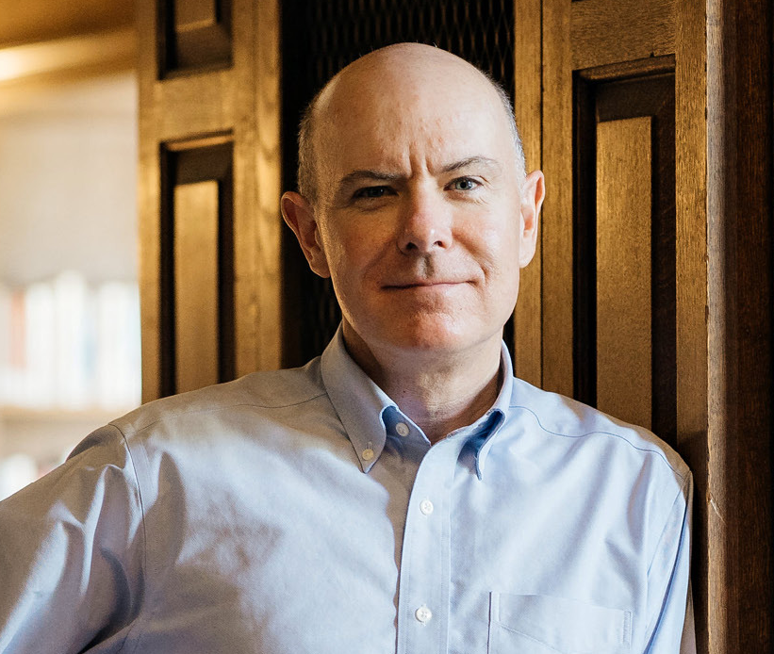
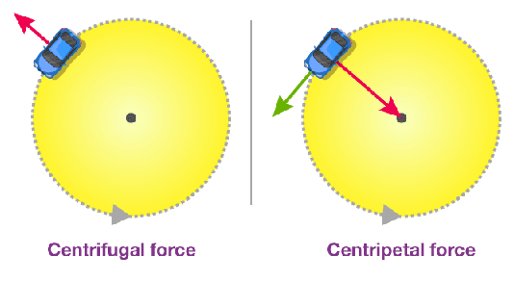
Understanding Globalization
Globalization as an interplay between centrifugal and centripetal forces
1940
1950
1960
1970
1980
1990
2000
2010
2020
2030
2040
2050…
In the history of the economy, these forces act to different degrees in different phases.
A centrifugal force moves something outwards. In our case, it causes countries to move further apart economically.
Centripetal forces bring economies closer together.
Douglas Irwin: „Wir werden noch wehmütig auf die Phase des nahezu komplett globalisierten Welthandels zurückblicken“ https://www.brandeins.de/magazine/brand-eins-wirtschaftsmagazin/2022/logistik/douglas-irwin-wir-werden-noch-wehmuetig-auf-die-phase-des-nahezu-komplett-globalisierten-welthandels-zurueckblicken
Notes:
New master‘s programme in public administration designed in cooperation with local authorities in Brandenburg. English is expressly forbidden, it would frighten off applicants. Dient zur Abschreckung! English would only put people off. A condition of the TH offering the master‘s programme that there would be no English. This is for civil servants in managerial positions in Land Brandenburg.

Slide 19
Email from international student
Hello,
I hope you are doing well. I recently returned from Pakistan and have just begun this course. As a result, I am uncertain about the number of classes I may have missed during my absence. Would you kindly provide me with an overview of the course and any pertinent information regarding missed classes?
Your asssistance in clarifying this matter would be greatly appreciated.
Thank you in advance for your attention to this request.

Slide 20
German professor‘s response
Dear Ebaduallah,
Students at German universities are characterised by the independence with which they pursue their educational goals. This also included making up for their own shortcomings. With this in mind, I ask you to study the content and information available on the learning platform and to enquire with fellow students.
I will be happy to answer any specific questions you may have.
Kind regards,

