Slide 1
A Diversity of Methods and Materials. How to apply this in Modules
Javier Ávila University of Cordoba
Notes:
Good evening everybody, thank you to the HAN and the coordination of CLIL4ALL for putting all this together and the invitation to have this workshop, I have to admit this came as a surprise, because we in fact proposed one originally but it wasn’t programmed in the first versión if I remember properly..
Welcome to this workshop on Materials development as one of the key elemensts of ICLHE sustainability.
Well, we have been involved in the design and implementation of HIGHER EDUCATION CLIL, NOW ICLHE for a while. OUT of experience in teacher training and the view we have had to the educational sites of different universities, our perception is that NEXT SLIDE

Slide 2
Sustainability
One of the main hurdles in the implementation of CLIL/ICLHE has been the development of efficient learning materials.
Notes:
In fact, the UCO offered a teacher training seminar this year but it had to be called off because of low registration.
THAT plays havoc with the sustainability of the programs, because Materials development is in fact “one of the essential components of the ICLHE curriculum.
There is in fact a high RATE of dropout or sluggish ICLHE practice mainly because of the steep nature of proper materials development for 2 main reasons:
Lack of knowledge of the underpinnings of CLIL/ICLHE Materials Development
Lack of time to develop proper materials.

Slide 3
Academic & Language Skills
CLIL ‘hard’ versions tend to place their emphasis almost exclusively on the content, with little attention to language. (Ball, Kelly & Clegg, 2015).
Evans and Morrison (2011: 207): “EMI university lecturers take “little or no account of the quality of students’ English.”
Notes:
WE ARE SUPPOSED TO PROMOTE ACADEMIC & LANGUAGE SKILLS, BUT WHAT WE HAVE SEEN is that ICLHE is the HE version of “hard CLIL” AS (Ball, Kelly & Clegg, 2015) UDERLINED, and those version almost exclusively forget about attention to language.
As Evans & Morrison (2011) point out
If we take for example Pellicer-Ortín et al. (2016) they are talking about CLIL in higher education but what we get there is basically English taught courses of psychology and education.
Another good example is “Integrating CLIL in transcultural education: A practical guide for HE teachers” Out of the Erasmus + project Transcultural Nursing: A European Priority, a Professional Responsibility (TC-Nurse).
They go: “it is not very realistic to expect them to be able to do some of the following tasks: • Immediately understand a subject specific text in English. • Immediately understand the content of a video or audio and apply the knowledge in a discussion or debate. • Be able to write genre specific texts without any type of support or modelling”
The SOLUTIONS THEY OFFER are basically: The mix of textual styles for presentations. Does it have visuals, tables, diagrams, graphics, as well as text, and to watch out the level of vocabulary and grammar in the texts.
When they talk about genre (3 times in the document): Teacher presents the same content through using a variety of genres (re-presented as drama, narrative, report, exposition, tautological transformation, theory, poem, third-person historical narratives, eyewitness accounts, scientific texts, letters, cooperative posters, ...)
Well, we are not here to discuss that, that is basically some food for thought

Slide 4
Mediation
MD
COURSE CONTENT
TEACHER
STUDENTS
Notes:
We think we may be losing a crucial opportunity for taking ICLHE to the next level. MD plays such a central role in ICLHE because they effectively mediate between the course content, the LECTURER and STUDENTS. ...

Slide 5
Principles for materials development
Meyer (2010),
  Input
  Tasks
  Output
  Scaffolding (p.305).
Notes:
ANALYSING CLIL, MEYER (2010), established that the core elements of CLIL materials were: input, tasks, output and scaffolding (p.305).
We can keep Input / tasks / output but need to reformulate scaffolding in the light of what is to come later, IN FACT…IF WE FOCUS ON THE WORK PLAN (NEXT SLIDE)

Slide 6
Focus on the Work plan
Tasks
Activity (??)
Questions
Notes:
We may center on the task, it is one of the work plans that we can ask our students to perform but it will not be the only one, the others being an activity or exercise and different kinds of questions.
BUT ACTIVITIES ARE BASICALLY ORIENTED TOWARDS THE USE OF LANGUAGE SO WE DO NOT REALLY NEED THEM IN ICLHE, WELL WE NEED THEM, BUT THE QUESTION IS WHO IS GOING TO DEAL WITH THEM OR RATHER HOW
SO WE ARE LEFT WITH TASKS AND QUESTIONS, let's start with TASKS

Slide 7
TASK
Providing higher order thinking
Encouraging subject specific study skills
Promoting student interaction and authentic communication
Notes:
WORKSHOP HOW TO DO THAT????
LET’S SEE THE TASK FIRST.
BECAUSE ICLHE IS BASICALLY ORIENTED TOWARDS TASKS
A task is a central element in a work plan because it will determine what we ask our students to do with both the content and the language, it should be characterised by
providing higher order thinking,
encouraging subject specific study skills (Meyer, 2010).
promoting student interaction and authentic communication
WHY?????
PROCEDURE: Lecture / Ok, How would you do that?
ESTO NO There has been many attempts to clarify the concept of task, here we will refer to those processes that comply with the following criteria, as established by Ellis (2009):
The primary focus should be on ‘meaning’ (by which is meant that learners should be mainly concerned with processing the semantic and pragmatic meaning of utterances).
There should be some kind of ‘gap’ (i.e. a need to convey information, to express an opinion or to infer meaning).
Learners should largely have to rely on their own resources (linguistic and non-linguistic) in order to complete the activity.
There is a clearly defined outcome other than the use of language (i.e. the language serves as the means for achieving the outcome, not as an end in its own right).

Slide 8
Focus on Interaction
(Pimentel-Velázquez & Pavón, 2020)
Content / LREs
Interaction
Negotiation
Kim (2012)
Notes:
According to (Pimentel-Velázquez & Pavón, 2020) such work plans should promote interaction among students
2. Rubric PREVIOUS ACTIVITY (2way/participants/Agreement-Negotiation/ LREs??)
If interaction is to be promoted, lecturers should bear in mind, according to Robinson (2007),
if the exchange of information goes one way or if it is reciprocal
the number of participants that will interact,
whether agreement between participants is required and whether contributions require negotiation and to what extent.
If students are asked to interact, there might be negotiation of meaning between them and therefore there can be an increase not only on content learning but on Language-Related-Episodes (LREs), which are instances in the communicative interactions among learners when they question, talk about or self- correct or correct others’ language use (Kim, 2012).

Slide 9





QUESTIONS
Dalton-Puffer (2007)
Facts
Explanations
.
Reasons
Opinions.
Llinares, Morton and Whittaker (2012).
Metacognitive
Notes:
1ST. WHAT KIND OF QUESTIONS DO YOU THINK WE TEACHERS NORMALLY ASK IN CLASS??
PROCEDURE: 1ST Lecture / 2nd Workshop. Develop question
With regards to the kinds of questions that teachers and lecturers can ask, different categories have been provided, here we will use the typology established by Dalton-Puffer (2007) based on “the types of information being asked for” (p.98):
In ICLHE, We want to aim for Meta-cognitive questions: they require that the students “reason their own point of view or way of thinking”, i.e Why are you saying this? Why do you think this is correct/incorrect, etc?
SO...Longer and more COMPLEX answers are provided (Mercer,et. al, 2004), Dalton-Puffer (2007), Meyer (2010b).
SO....more and better LREs
We have to acknowledge that there is a strong tradition for factual questions in our educational system (Dalton-Puffer, 2007; Meyer, 2010).
TRANSITION: NOW WE WANT TO TUNE THE WORKPLAN TO THE CDFs,
The importance of the kinds of questions asked to students comes from studies that demonstrate that when students have to explain and justify their views then longer and more complex responses are produced (Mercer,et. al, 2004), this is in line with Dalton-Puffer (2007). She analysed teachers’ questions in Austria and found out that those questions that produced most complex responses on the part of students were “meta-cognitive” questions. However, these were scarcely used in classrooms as most of the questions posed by teachers were “factual questions”, which made students’ interactions undemanding. This is also in line with Meyer (2010b), who claimed that approximately 80% of the total annual questions posed by teachers in classrooms were related to factual knowledge.

Slide 10
Learning as a cognitive event
Observable analogues
Discursive interaction
Notes:
Since learning as a cognitive event is not directly observable, SO WE HAVE TO RELY ON observable analogues. In the case of ICLHE, these analogues are to be sought in the classrooms and the discursive interaction between teachers and learners in them
this is where CONTENTS are ‘talked into being’ (e.g. Edwards & Mercer, 1987; Ehlich & Rehbein, 1986; Mercer, 2000; Wells, 1999). SO….TO ACHIEVE THIS GOAL….WE NEED INTERACTION & NEGOTIATION

Slide 11

Focus on CDF
(Dalton-Puffer, 2013, 2016)
Notes:
LET ME now focus on CDF, THE LAST ELEMENT TO BE INCLUDED in the tool we are proposing today is that of the CDF.
We come here to the juicy part of the cake CDF
THEY ARE “VERBAL ROUTINES that have arisen in answer to recurring demands” (p. 29) within disciplines. That is, PARTICIPANT VERBALISATIONS that represent KNOWLEDGE OBJECTS”, that are constitutive of learning themselves. AND….NEXT SLIDE
THERE ARE SOME STUDIES DoÍz, A., & Lasagabaster, D. (2021) show how the LECTURERS use COMPLEX CDF, (they use “in the transmission of knowledge”) and Breeze & Dafouz (2017) show how university students use them in exams, but unfortunately there is a dearth of studies on how to promote their use on the side of the students.
BECAUSE….
participant verbalisations, which make the learning matter intersubjectively accessible and represent knowledge objects, thought processes and epistemological stance, are constitutive of learning itself. These verbal actions I call cognitive discourse functions (sometimes also referred to as academic language functions). CDFs thus are verbal routines that have arisen in answer to recurring demands while dealing with curricular content, knowledge items and abstract thought. The actional demands as such (e.g. classifying, hypothesising) and the requirement that students demonstrate the ability to enact them, are regular features in today’s competence oriented school-curricula

Slide 12
VERBAL ROUTINES that have arisen in answer to recurring demands” within disciplines.
That is, PARTICIPANT VERBALISATIONS that represent KNOWLEDGE OBJECTS”, that are constitutive of learning themselves

Slide 13
How CDFs can inform CLIL practice in the design and development of teaching materials. Morton (2020)
Notes:
WE'VE NOW COME TO THE ICING OF THE PECHA-KUCHA, following, Morton 2020

Slide 14
CDFs as a bridge
CDF
Content learning objectives
The specific types of communication (literacies)
Language used to express knowledge and thinking
Notes:
PROCEDURE: 1 Lecture / 2.
THEY MAY BE USED AS A BRIDGE linking
content learning objectives
the specific types of communication (literacies) associated with academic subjects
language used to express knowledge and thinking.
DIFFERENT DISCIPLINES have their own specific types of communication, (Sanchez-Pérez, 2021)most often seen in the text types (or GENRES) which are typically used.

Slide 15
Text types (genres)
Textual result of social interaction
Central language units in curricula (Feez 2001; Kress 2007).
Genre-based syllabus (Lorenzo, 2013; Sánchez-Perez, 2021)
Textual properties of the discourse of the disciplines
Notes:
THE GENRES which are typically used in a discipline are the TEXTUAL RESULT OF SOCIAL INTERACTION, including the TEXTUAL PROPERTIES of the DISCIPLINE. FEEZ 2001 AND KRESS 2007 in fact propose that GENRES SHOULD BE THE CENTRAL UNITS IN CURRICULA (LORENZO, 2013, FOR APPLYING THIS TO CLIL)
So IN THE LIGHT OF ALL THIS…WE HAVE READAPTED CYNTHIA’S RUBRIC FOR MATERIAL EVALUATION INTO A DECLARATION OF INTENT AND SELF-EVALUATION TOOL FOR THE PRACTICIONERS
genre-based syllabus (Lorenzo, 2013)
genres are seen as the textual result of social interaction and given the power granted to those who excel at their composition, the case is made that they should be the central language units in curricula to warrant equality in education (Feez 2001; Kress 2007).
Textual properties of the discourse of the disciplines: the discourse of science, the discourse of history, etc.
genre-based approach to CLIL education would rely more on formulaic sequences and fixed sentence fragments related to content units than sequences of grammar rules.
However, when it comes to drawing students’ attention to the formal linguistic properties of their area genres a commercial memo for business teachers, a fieldwork observation sheet in science or an arithmetic problem in maths their involvement in the task is seen as wholly appropriate.

Slide 16
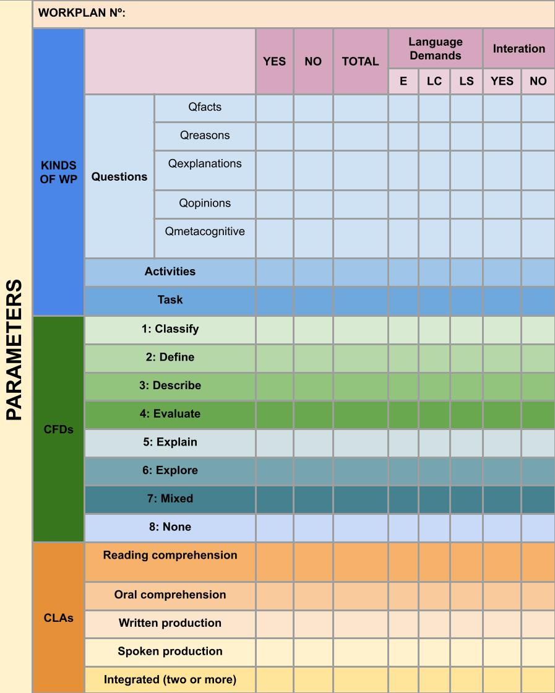
Materials development rubric
Notes:
Las CLAs COMMUNICATIVE LANGUAGE ACTIVITIES
REPOSITORIO

Slide 17
MD
Notes:
The tool has a double function,
On the ONE SIDE we are asssessing ICLHE practice in different Universities,
On the OTHER we are using the tool to train lecturers at our courses in UCO and the ones we do in different universities.
CLAs = COMM. LANGUAGE ACTIVITIES

Slide 18

The Rubric

Slide 19
References
Breeze, R., & Dafouz, E. (2017). Constructing complex Cognitive Discourse Functions in higher education: An exploratory study of exam answers in Spanish- and English-medium instruction settings. System, 70, 81–91. https://doi.org/10.1016/j.system.2017.09.024
Dalton-Puffer, C. (2007). Discourse in content and language integrated learning (CLIL) classrooms. Philadelphia, PA, USA: John Benjamins Publishing.
Dalton-Puffer, C. (2013). A construct of cognitive discourse functions for conceptualising content-language integration in CLIL and multilingual education. European Journal of Applied Linguistics, 1(2), 216-253.
Dalton-Puffer, C., Bauer-Marschallinger, S., Brückl-Mackey, K., Hofmann, V., Hopf, J., Kröss, L., & Lechner, L. (2018). Cognitive discourse functions in Austrian CLIL lessons: towards an empirical validation of the CDF Construct. European Journal of Applied Linguistics, 6(1), 5-29.
Derewianka, B., & Jones, P. (2016). Teaching language in context. South Melbourne, Australia: Oxford University Press.
Doiz, A., & Lasagabaster, D. (2021). An analysis of the use of cognitive discourse functions in English-medium history teaching at university. English for Specific Purposes, 62, 58–69. https://doi.org/10.1016/j.esp.2020.12.002
Ellis, R. (2009). Task‐based language teaching: Sorting out the misunderstandings. International journal of applied linguistics, 19(3), 221-246.
Evans, S., & Morrison, B. (2011). Meeting the challenges of English-medium higher education: The first-year experience in Hong Kong. English for Specific Purposes, 30, 198-208.
Feez, S. 2001. Text-Based Syllabus Design. Sydney: Macquaire University.
Kim, Y. (2012). Task complexity, Learning opportunities, and Korean EFL Learners’question Development. Studies in Second Language Acquisition, 34(4), 627-658.
Kress, G. (2007). ‘‘Meaning, Learning and Representation in a Social Semiotic Approach to Multimodal Communication.’’ In Language and Literacy: Functional Approaches, edited by R. Whittaker, M. O’Donnell, and A. McCabe, 1637. London: Continuum.

Slide 20
References
Llinares, A., & Pascual Peña, I. (2015). A genre approach to the effect of academic questions on CLIL students’ language production. Language and Education, 29(1), 15-30.
Mercer, N., Dawes, L., Wegerif, R., & Sams, C. (2004). Reasoning as a scientist: Ways of helping children to use language to learn science. British educational research journal, 30(3), 359-377.
Meyer, O. (2010). Introducing the CLIL-pyramid: Key strategies and principles for quality CLIL planning and teaching. Basic issues in EFL-teaching and learning, 11-29.
Meyer, O. (2010b). Towards quality CLIL: successful planning and teaching strategies. PULSO. Revista de Educación (33), 11–29.
Morton, T. (2020). Cognitive discourse functions: A bridge between content, literacy and language for teaching and assessment in CLIL. CLIL Journal of Innovation and Research in Plurilingual and Pluricultural Education, 3(1), 7-17.
Pimentel-Velázquez, C. Y., & Pavón-Vázquez, V. (2020). The Pedagogical Dimension and the Use of Materials in English-Taught Programs in Higher Education. In Teacher Training for English-Medium Instruction in Higher Education (pp. 320-339). IGI Global.
Robinson, P. (2007). Criteria for classifying and sequencing pedagogic tasks. In M.P García Mayo (Ed.), Investigating tasks in formal language learning, (pp. 7-26). Multilingual Matters Ltd.

Slide 21
Any questions?
You can find me at
javila@uco.es
?

